Slide 1
Recurrent NN
Deep Learning

Slide 2
The Inception of RNN
ANN that do not have looping nodes and are called feed forward neural networks.
all information is only passed forward, also referred as a multi-layer neural network.
appropriate for image classification tasks, for example, where input and output are independent
inability to retain previous inputs automatically renders them less useful for “sequential data analysis”
RNN Suitable for Datasets: Time-Series data and text data.

Slide 3
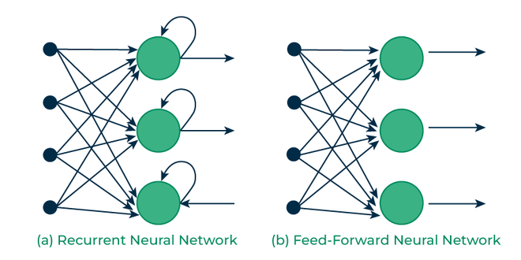
RNN Vs FFNN

Slide 4
RNN
An RNN is a neural network that is specialized for processing a sequence of data x(t)= x(1), . . . , x(τ) with the time step index t ranging from 1 to τ.
output from the previous step is fed as input to the current step
Ex: it is required to predict the next word of a sentence; the previous words are required and hence there is a need to remember the previous words.
most important feature of RNN is its Hidden state, which remembers some information about a sequence.
The state is also referred to as Memory State since it remembers the previous input to the network.
It uses the same parameters for each input as it performs the same task on all the inputs or hidden layers to produce the output. And so are called recurrent (because they perform the same task for every element of a sequence)
This reduces the complexity of parameters, unlike other neural networks.

Slide 5
RNN
For tasks that involve sequential inputs, such as speech and language, it is often better to use RNNs.
In an NLP problem, if you want to predict the next word in a sentence it is important to know the words before it.
they have a “memory” which captures information about what has been calculated so far.

Slide 6
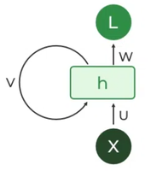
Recurrent Neuron
The fundamental processing unit in a Recurrent Neural Network (RNN) is a Recurrent Unit.
This unit has the unique ability to maintain a hidden state, allowing the network to capture sequential dependencies by remembering previous inputs while processing.
Long Short-Term Memory (LSTM) and Gated Recurrent Unit (GRU) versions improved the RNN’s ability to handle long-term dependencies.

Slide 7
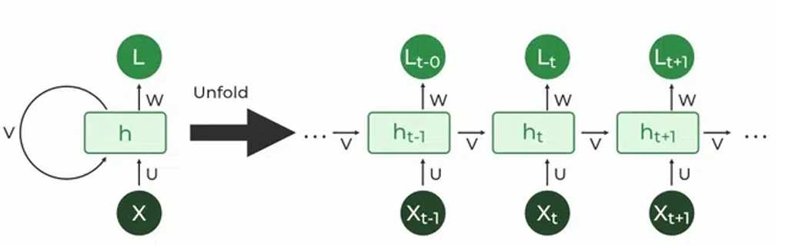
Unfold RNN

Slide 8
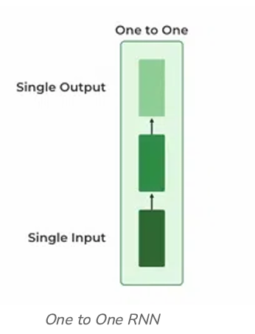
Types Of RNN
a) One to One :
Behaves the same as any simple Neural network, known as Vanilla Neural Network.
only one input and one output.
Ex: Feed-forward Network

Slide 9
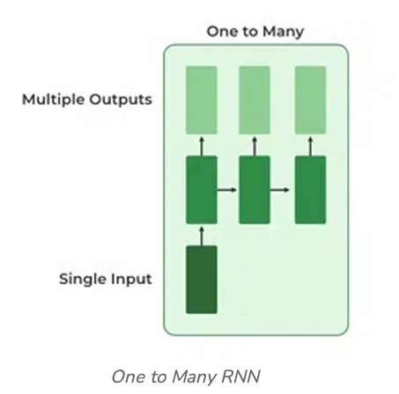
Types Of RNN
b) One To Many :
one input and many outputs associated with it.
examples of this network: Image captioning (given an image we predict a sentence having Multiple words).

Slide 10
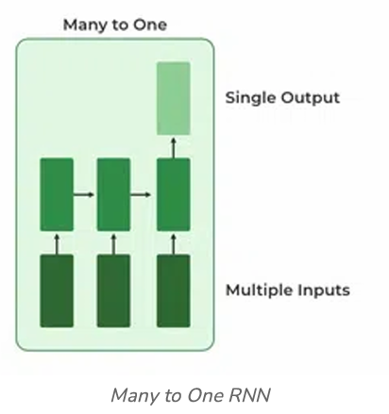
Types Of RNN
c) Many to One:
used in the problems like sentimental analysis.
Ex: multiple words as input and predict only the sentiment of the sentence as output.

Slide 11
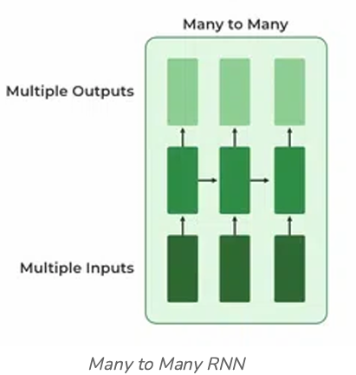
Types Of RNN
d) Many to Many:
multiple inputs and multiple outputs corresponding to a problem.
Example :language translation
In language translation, we provide multiple words from one language as input and predict multiple words from the second language as output.

Slide 12
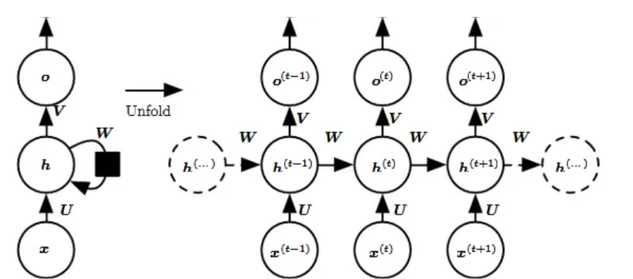
RNN Architecture
For example, if the sequence we care about is a sentence of 3 words, the network would be unrolled into a 3-layer neural network, one layer for each word.
Notes:
The left side of the above diagram shows a notation of an RNN and on the right side an RNN being unrolled (or unfolded) into a full network. By unrolling we mean that we write out the network for the complete sequence.

Slide 13
RNN
Input: x(t)​ is taken as the input to the network at time step t. For example, x1,could be a one-hot vector corresponding to a word of a sentence.
Hidden state: h(t)​ represents a hidden state at time t and acts as “memory” of the network. h(t)​ is calculated based on the current input and the previous time step’s hidden state:
h(t)​ = f(U x(t)​ + W h(t−1)​)
The function f is taken to be a non-linear transformation such as tanh, ReLU.

Slide 14
RNN
Weights: The RNN has input to hidden connections parameterized by a weight matrix U, hidden-to-hidden recurrent connections parameterized by a weight matrix W, and hidden-to-output connections parameterized by a weight matrix V and all these weights (U,V,W) are shared across time. (weights same)
Output: o(t)​ illustrates the output of the network. In the figure I just put an arrow after o(t) which is also often subjected to non-linearity, especially when the network contains further layers downstream.

Slide 15
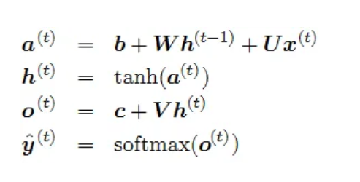
RNN: Forward Pass
We assume that the output is discrete, as if the RNN is used to predict words or characters.
A natural way to represent discrete variables is to regard the output o as giving the un-normalized log probabilities of each possible value of the discrete variable.
We can then apply the softmax operation as a post-processing step to obtain a vector ŷof normalized probabilities over the output.

Slide 16
Example: RNN Fwd pass
Assume , recurrent network that maps an input sequence to an output sequence of the same length.
The total loss for a given sequence of x values paired with a sequence of y values would then be just the sum of the losses over all the time steps.
We assume that the outputs o(t)are used as the argument to the softmax function to obtain the vector ŷ of probabilities over the output.
We also assume that the loss L is the negative log-likelihood of the true target y(t)given the input so far.

Slide 17
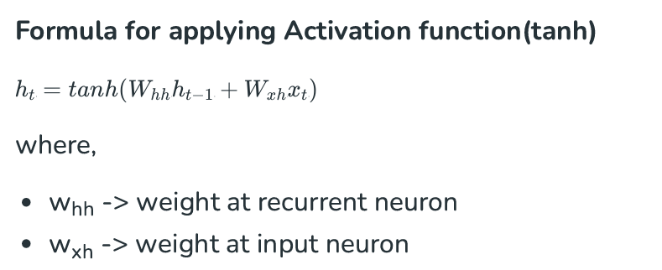
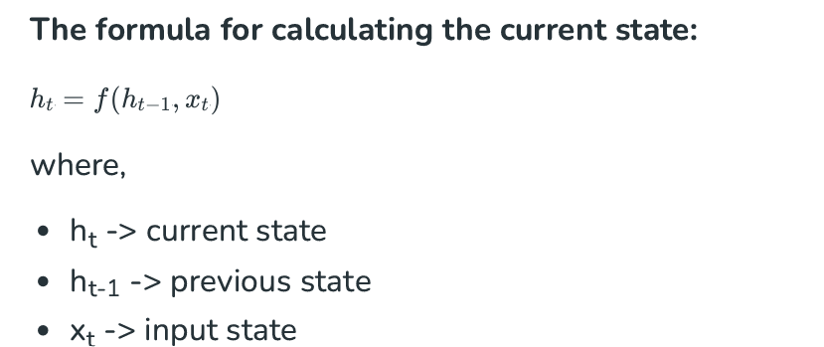
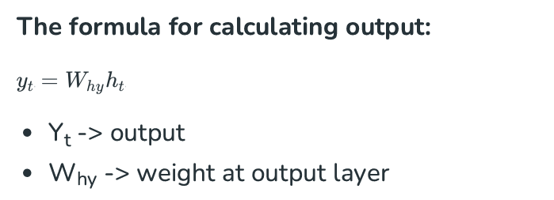
RNN
These parameters are updated using Backpropagation. However, since RNN works on sequential data here we use an updated backpropagation which is known as Backpropagation through time.

Slide 18
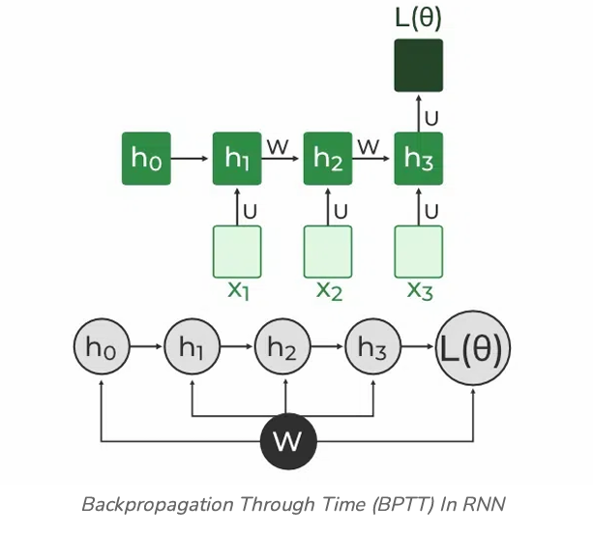
RNN: Backpropagation Through Time (BPTT)
In RNN the neural network is in an ordered fashion and since in the ordered network each variable is computed one at a time in a specified order like first h1 then h2 then h3 so on.
Hence we will apply backpropagation throughout all these hidden time states sequentially
L( θ )(loss function) depends on h3 h3 in turn depends on h2 and W h2 in turn depends on h1 and W h1 in turn depends on h0 and W where h0 is a constant starting state

Slide 19
Summary
Recurrent Neural Networks take the previous output or hidden states as inputs.
The composite input at time t has some historical information about the happenings at time T < t
RNNs are useful as their intermediate values (state) can store information about past inputs for a time that is not f ixed a priori

Slide 20
RNN: we know
RNN uses the previous information in the sequence to produce the current output.
example sentence: “Today is a good day.”
At the time(T0 ), the first step is to feed the word “Today” into the network. the RNN produces an output.
At the time(T1 ), then at the next step we feed the word “is” and the activation value from the previous step.
Now the RNN has information of both words “Today” and “is”.
And this process goes until all words in the sentence are given input
Note: In RNN weights and bias for all the nodes in the layer are same.

Slide 21
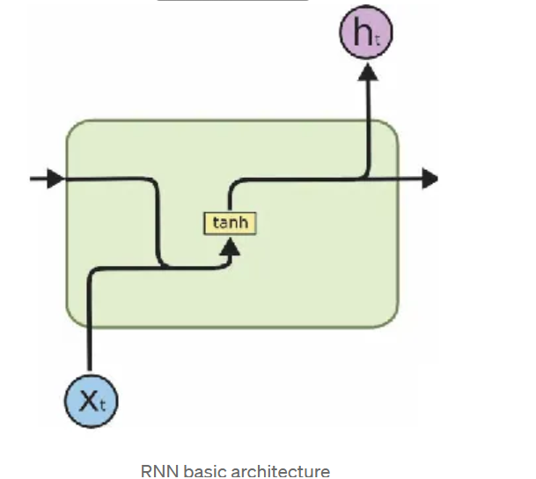
RNN:
takes input from the previous step and current input. Here tanh is the activation function, instead of tanh
we can use other activation function as well.
RNN’s face short-term memory problem. It is caused due to vanishing gradient problem.
As RNN processes more steps it suffers from vanishing gradient more than other neural network architectures.

Slide 22
vanishing gradient problem?
In RNN to train the network you backpropagate through time, at each step the gradient is calculated.
The gradient is used to update weights in the network.
If the effect of the previous layer on the current layer is small then the gradient value will be small and vice-versa.
If the gradient of the previous layer is smaller then the gradient of the current layer will be even smaller.
This makes the gradients exponentially shrink down as we backpropagate.
Smaller gradient means it will not affect the weight updation.
Due to this, the network does not learn the effect of earlier inputs. Thus, causing the short-term memory problem.

Slide 23
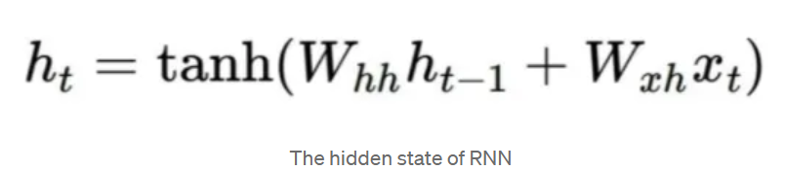
RNN –vanishing gradient
The main problem is that it’s too difficult for RNN to learn to preserve information over many timesteps. In vanilla RNN the hidden state is constantly being rewritten.
At this case, do we need RNN with a separate memory?

Slide 24
Vanishing gradient: solution
To overcome this problem two specialized versions of RNN were created. They are
GRU(Gated Recurrent Unit)
LSTM(Long Short Term Memory).
Suppose there are 2 sentences.
Sentence one is “My cat is …… she was ill.”,
the second one is “The cats ….. they were ill.”
At the ending of the sentence, if we need to predict the word “was” / “were” the network has to remember the starting word “cat”/”cats”.
So, LSTM’s and GRU’s make use of memory cell to store the activation value of previous words in the long sequences. Now the concept of gates come into the picture.
Gates are used for controlling the flow of information in the network and are capable of learning which inputs in the sequence are important and store their information in the memory unit. They can pass the information in long sequences and use them to make predictions.

Slide 25
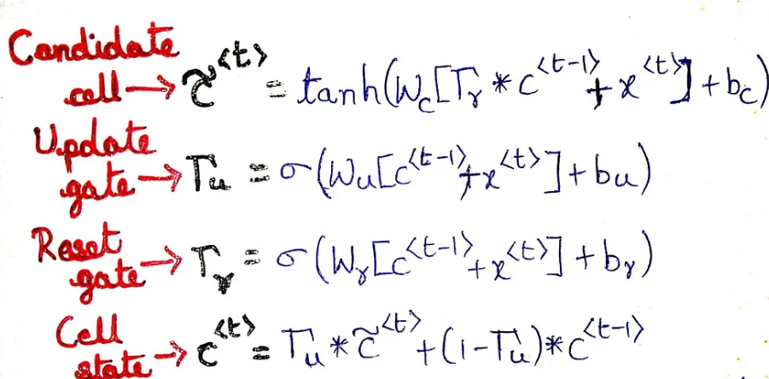
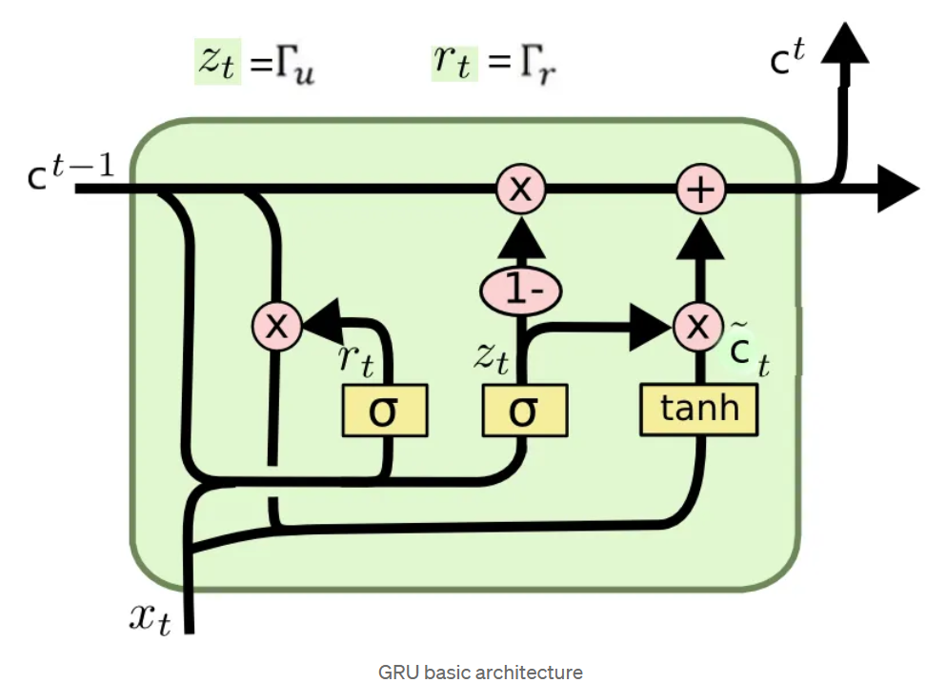
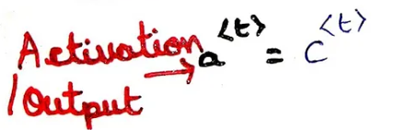
Gated Recurrent Units
The workflow of GRU is same as RNN but the difference is in the operations inside the GRU unit.
Inside GRU it has two gates
1)reset gate 2)update gate
Gates are nothing but neural networks, each gate has its own weights and biases(but don’t forget that weights and bias for all nodes in one layer are same).

Slide 26
GRU
In GRU the final cell state is directly passing as the activation to the next cell.
Update gate
Update gate decides if the cell state should be updated with the candidate state(current activation value)or not.
Reset gate
The reset gate is used to decide whether the previous cell state is important or not. Sometimes the reset gate is not used in simple GRU.
Candidate cell
It is just simply the same as the hidden state(activation) of RNN.
Final cell state
The final cell state is dependent on the update gate. It may or may not be updated with candidate state. Remove some content from last cell state, and write some new cell content.

Slide 27
GRU
If reset close to 0, ignore previous hidden state (allows the model to drop information that is irrelevant in the future).
If gamma(update gate) close to 1, then we can copy information in that unit through many steps!
Gamma Controls how much of past state should matter now.

Slide 28
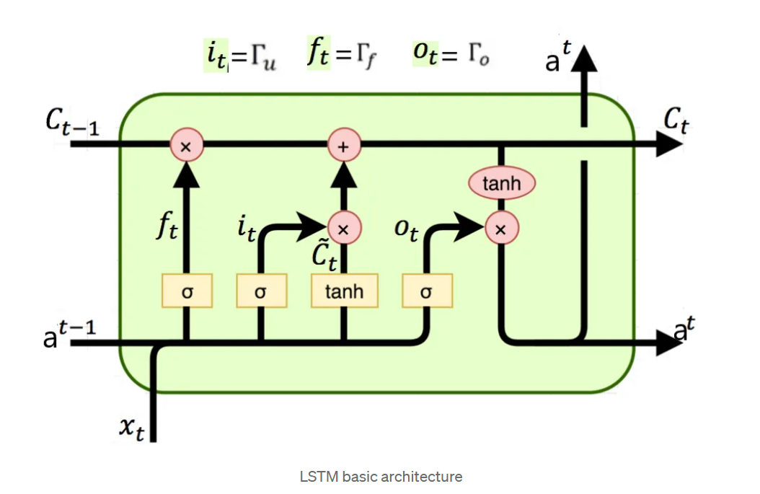
Long Short-Term Memory
LSTMs are much similar to GRU’s, they are intended to solve the vanishing gradient problem.
In Addition to GRU here there are 2 more gates
1)forget gate 2)output gate.

Slide 29
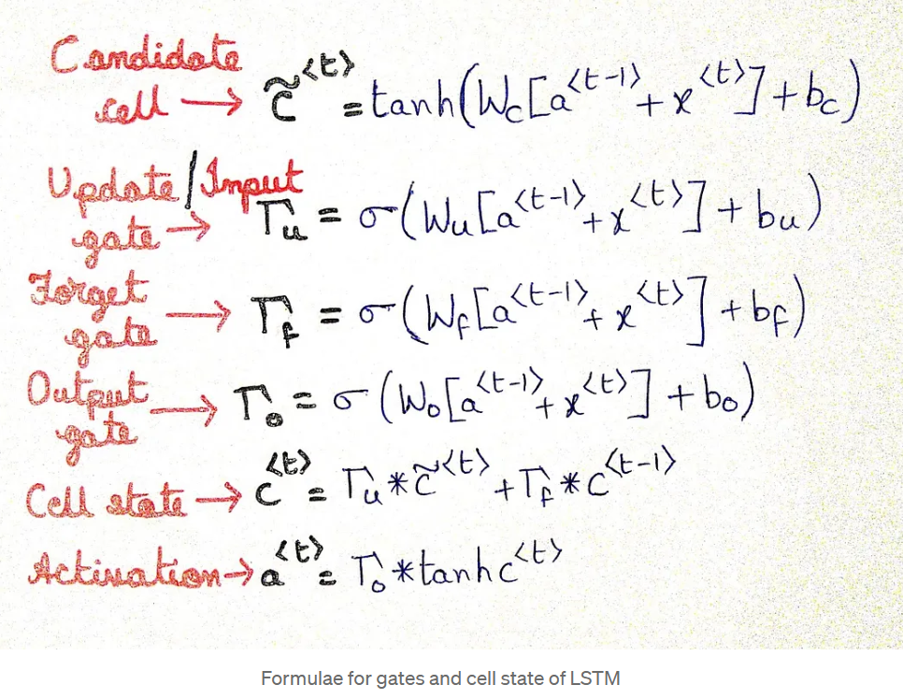
LSTM
All 3 gates(input gate, output gate, forget gate) use sigmoid as activation function so all gate values are between 0 and 1.

Slide 30
LSTM
Forget gate
It controls what is kept vs forgotten, from previous cell state. In laymen terms, it will decide how much information from the previous state should be kept and forget remaining.
Output gate
It controls which parts of the cell are output to the hidden state. It will determine what the next hidden state will be.

